Slide 1

Comments on EPCWD/GSA and the Basin JPA
by Director Reaugh
EPCWD/GSA Board Meeting – October 8, 2025

Slide 2
Major Factors Affecting Basin Sustainability
Mother Nature
Man-made GW Recharge
Extraction
EPCWD/GSA Board Meeting – October 8, 2025

Slide 3
Major Factors Affecting Basin Sustainability
X
Mother Nature
Man-made GW Recharge
Extraction
EPCWD/GSA Board Meeting – October 8, 2025

Slide 4
Major Factors Affecting Basin Sustainability
X
Mother Nature
Man-made GW Recharge
Extraction
X
Not realistic in Paso Basin
EPCWD/GSA Board Meeting – October 8, 2025

Slide 5
Major Factors Affecting Basin Sustainability
X
Mother Nature
Man-made GW Recharge
Extraction
X
Not realistic in Paso Basin
To fulfill the basic requirements of SGMA and achieve a sustainable Basin, we must address extraction.
EPCWD/GSA Board Meeting – October 8, 2025

Slide 6
Brief History of Paso Basin
Date | Event | Extraction Mgmt.
Sept. 2015 | SGMA becomes Law | GW Pumping at will
2017 | PBCC Forms | GW Pumping at will
Jan. 2020 | Paso Basin GSP Submitted | GW Pumping at will
May 2025 | JPA Forms | GW Pumping at will
202? | JPA institutes Demand Management | Extraction is managed by agreed rules
EPCWD/GSA Board Meeting – October 8, 2025

Slide 7
Opinion
The current financial and governance relationship between the JPA and EPC places EPC in an untenable position!
EPCWD/GSA Board Meeting – October 8, 2025

Slide 8
Opinion & Recommendation
The current financial and governance relationship between the JPA and EPC places EPC in an untenable position!
Without substantial changes to JPA Agreement, EPC should withdraw from the JPA.
EPCWD/GSA Board Meeting – October 8, 2025

Slide 9
Reforms at JPA
¾ vote needs to change to unanimous
The JPA was voluntarily formed so that the four GSAs could manage the Basin collectively with one GSP. Unanimous vote insures consensus has been reached.
Policy, Regulatory and Basin administration activities should be funded equally between GSA members.
Shared authority should translate into commensurate shared financial responsibility.
Management actions, programs & projects should be funded by Prop 26 based on extraction.
EPCWD/GSA Board Meeting – October 8, 2025

Slide 10
What a new Budget might look like!
EPCWD/GSA Board Meeting – October 8, 2025

Slide 11
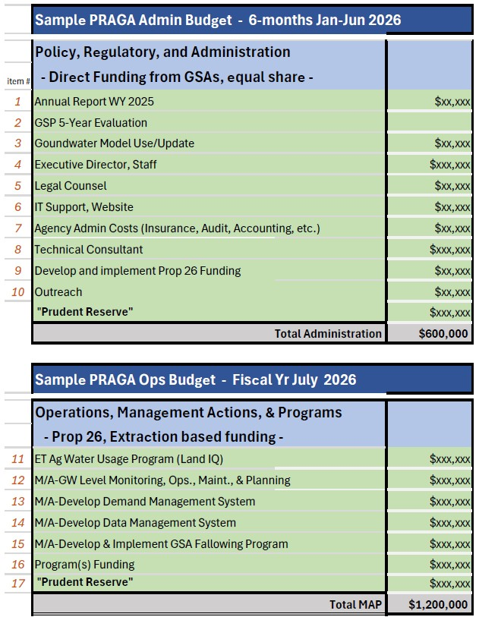
EPCWD/GSA Board Meeting – October 8, 2025

Slide 12
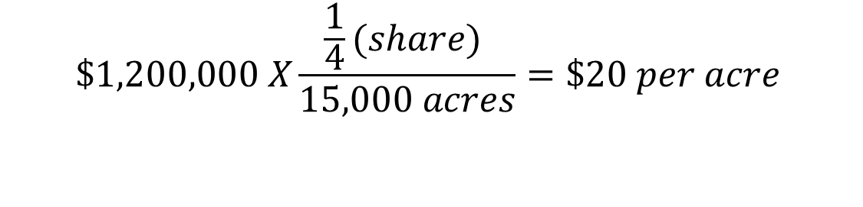
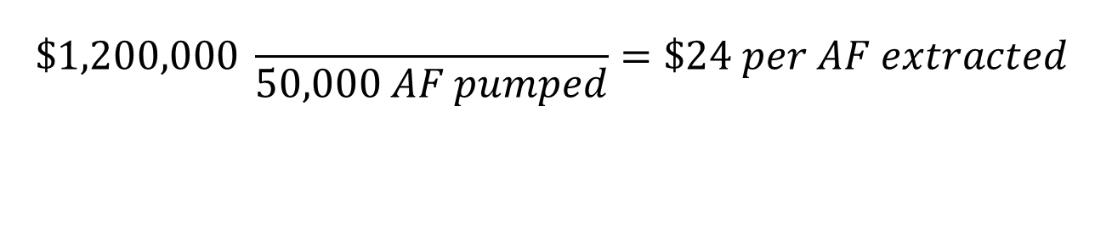
EPC Annual Cost Breakdown
Admin Costs
$$\$1,200,000 X\frac{\frac{1}{4}(share) }{15,000 acres}=\$20 per acre$$
M/A & Programs Costs
$$\$1,200,000 \frac{}{50,000 AF pumped}=\$24 per AF extracted$$
EPCWD/GSA Board Meeting – October 8, 2025

Slide 13
Timeline
October – JPA sets new course
November – JPA Agreement revised
December – Approved Budgets and committment to Prop 26
January – Ready to GO! Direct Funding in place
April – Prop 26 implemented
July – Prop 26 funds begin to flow
EPCWD/GSA Board Meeting – October 8, 2025

Slide 14
Thank you for listening,
…
It’s been an honor to work with you all,
…
I wish you great success in the future!
EPCWD/GSA Board Meeting – October 8, 2025

